Slide 1
BE – Job Interview
Yogev Magal

Slide 2
“The Endless drinks PUB”
In this job interview you will be asked to design and implement the following:
You own a PUB where there are many customers coming to drink and have fun…
Your bartender is trying to figure out what is the next drink to prepare…
For that, you will need to design and implement the smart machine that will
Print out to the bartender the next drink to prepare.

Slide 3
Rules of the PUB
In the PUB we have a menu which offers 3 kinds of drinks – each of them is having its own id.
Mochito – The bartender hates to make it… It will be served as low priority.
Beer – This is the common drink, will be served as medium priority
Cosmopolitan – Mostly for women. “Women first” – will be served as high priority
On top of this menu, you, as the manager of the PUB can declare one or more “Happy Hour” occasions. Each of those is going to be executed every X seconds Interval where once this interval is arriving, the machine will consider this special drink as the next one according to the priority of It and the initiation date of the order.
For every “Happy Hour” interval coming the machine will print the bartender a request to prepare a special drink called “Kopangan Bucket” with one of the drinks from the menu – but every bucket will have a different id of the other menu drinks since this is a bucket!
This bucket will be shared will all the customers and everyone can enjoy this FREE drink!

Slide 4
Rules of the PUB
The bartender will get the next drink printout from the machine one by one.
The bartender is capable on preparing any drink within exactly 5 seconds.
The machine will consider the priority of each drink where in case there are multiple drinks in the order the one with the high priority will go first, afterwards the medium and low.
In case there are two drinks with same priority, the one who ordered first will be the first one. In case of “Happy Hour” order – the date of the initial “happy hour” order will take place.
When a “Happy Hour” interval is arriving – bartender will start preparing the “Kopangan Bucket” with the selected drink assuming its priority against the other regular orders. (E.g – In case there is “Happy Hour” executed now with medium priority while there is a HIGH priority order in place, the ”Kopangan bucket” will have to wait for the high order to complete)

Slide 5

Assumptions
1
1
There can be multiple recurring “Happy Hours” with multiple priorities
2
Each order is containing a single drink only
There cannot be a case where both drinks have same priority and same order date (since it is ordered one drink at a time)
3
4
The machine can have only 50 drinks stored within it, but still should handle all orders up to that limit
5
You can assume that the bartender is starting to prepare a new drink every 5 seconds

Slide 6
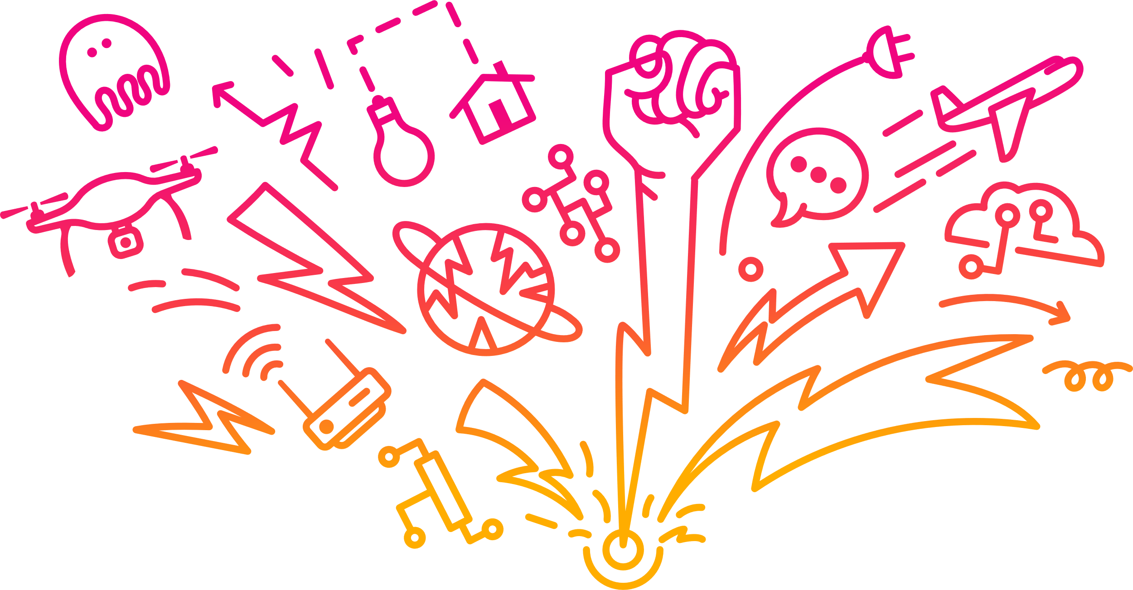
Where to start?

Slide 7
Tasks
Part I
Draw and explain the System Design for the machine that should handle the different orders coming

Slide 8
Tasks
Part II
Consider this interface as the only integration point with the machine (next page)
Implement the interface methods making sure to cover all the rules of the PUB while ensuring:
Clean code
Latest Java syntax
Efficiency
Design patterns
Edge cases
Writing tests

Slide 9
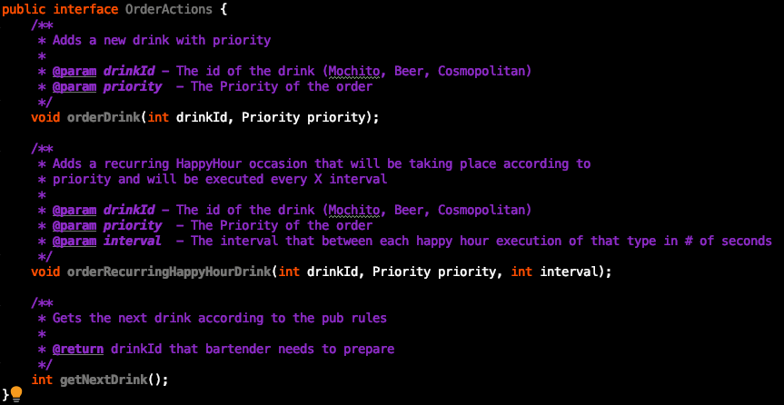
Tasks

Slide 10



